Slide 1


AI – Vision to Reality Student Workshop January 30, 2026

Slide 2
Agenda
Welcome & Introductions
Review Workshop Objectives
AI Background Info
Configuring the Environment
Lunch / Presidio Presentation (Downstairs in Room 117)
Arduino Setup
Putting It All Together
Wrap Up / What’s Next? – Target to finish the day by ~3pm

Slide 3





Who’s Who
Instructors:
Students:
Jeff Banham
Assistant Professor Cloud Infrastructure
jkbanham@waketech.edu
Who are you?
Note some “get-to-know you” questions:
Degree programs?
Who has coding experience?
Questions?
Jim Matlock
Assistant Professor Computer Programming
jmatlock1@waketech.edu
Guests / Sponsors, etc (Presidio, Microsoft, Wake Tech)

Slide 4
Workshop Objectives
Technical Skills​
- Python
- Azure
- APIs
- Arduino
- Servos​
“Soft” Skills​
- Meet fellow students
- Collaborate
- Have Fun!

Slide 5

RTP Campus Building 1 Facilities
Pictures / Vids – posting to social media approval
No food or drink in classroom
Lunch
Materials are owned by Wake Tech
Information you learn can be shared!
If you have to leave before we finish:
Be sure to complete feedback form at end of deck
Be sure to get your swag bag!

Slide 6

Watch for this slide throughout the deck!
We will checkpoint throughout the day to ensure everyone is on the same page?
Help each other out!
CHECKPOINT
If you get behind we’ll wait! If you want to work ahead we might ask you to slow down (and put on your teacher’s assistant hat!)

Slide 7

Links exist throughout the deck to dive more deeply into some of the topics we cover
Great for followup after the workshop!

Slide 8
What we’re working towards today!
Show the working model
Talk about encouraging creativity / no bad questions / help each other out / probs will occur

Slide 9
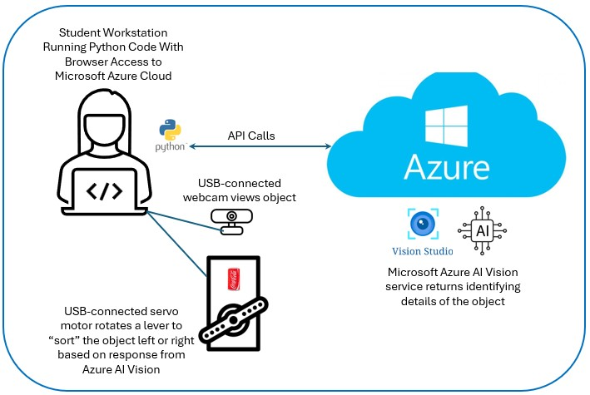
DOWNLOAD THE SLIDES HERE TO FOLLOW ALONG:
<url to slide deck in github goes here>

Slide 10

Artifical Intelligence
What exactly is it?

Slide 11

What is AI
What is first thing you think of?
Discuss positives / negatives

Slide 12
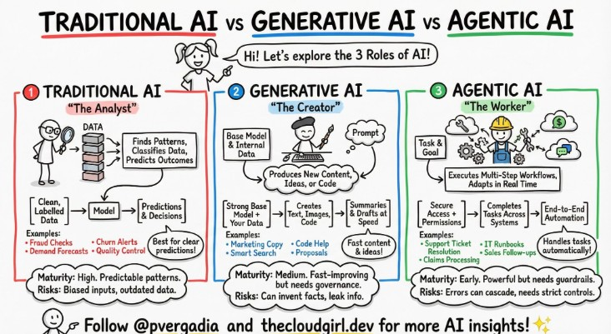
What do you think of when you hear “AI”?
Discussion:
Why learn about AI
Contrast Positive Uses & Abuses of ComputerVisionAI
Examples – autonomous driving, cancer research, facial recognition

Slide 13
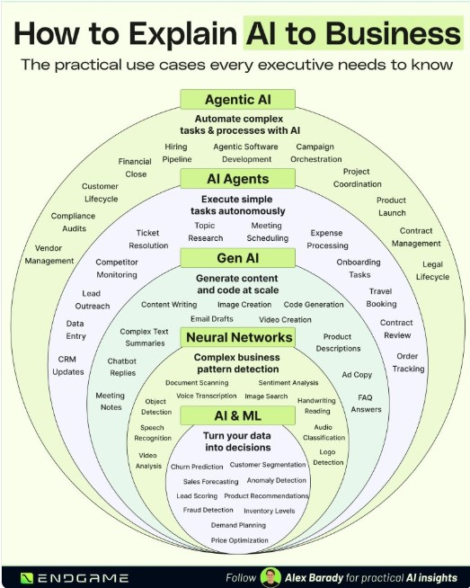
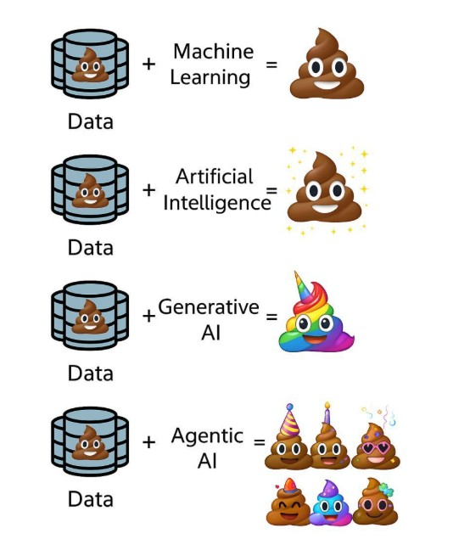

Slide 14
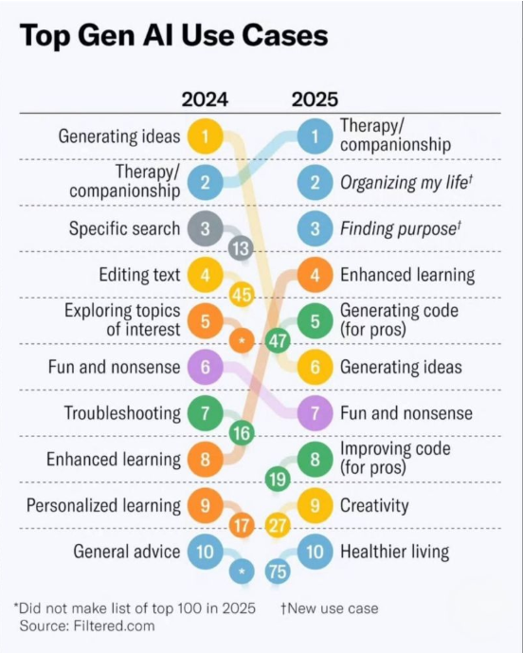

Slide 15
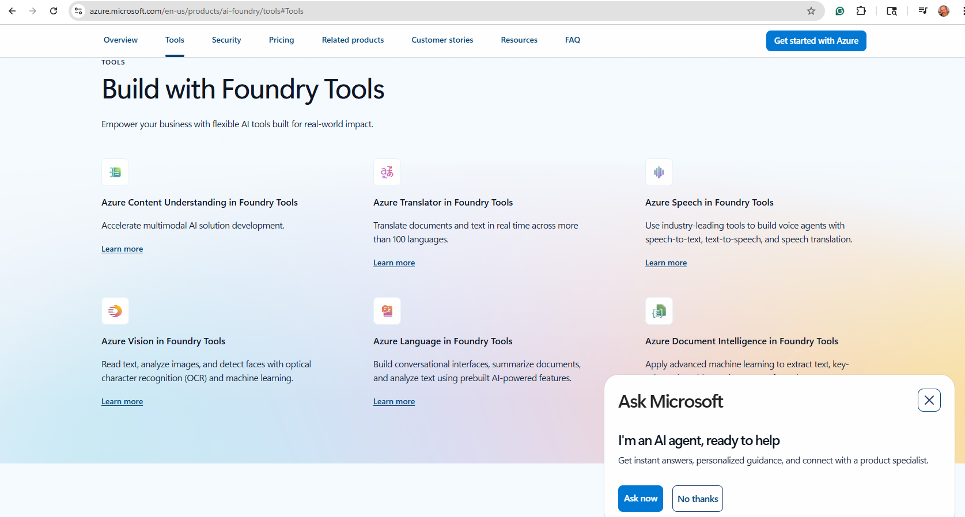
Azure AI Foundry

Slide 16

Environment Setup

Slide 17
What is Visual Studio Code?
Microsoft’s Integrated Development Environment (IDE) tool.
Used by developers working in various coding languages for the following reasons:
Increased Productivity & Efficiency: Automates repetitive tasks, allowing for faster coding and less context switching between different applications.
Smarter Code Editing: Features like syntax highlighting, auto-completion, and error detection help you write correct and readable code more quickly.
Integrated Debugging: Built-in debuggers let you set breakpoints, step through code, and inspect variables to find and fix bugs easily.
Streamlined Project Management: Tools for file management, building, and version control (like Git) keep large projects organized.
Enhanced Code Quality: Real-time feedback and automated testing frameworks help catch mistakes early, improving overall code quality.
Better Collaboration: Integrates with source control systems (like GitHub), making it easier for teams to share and manage code.
Centralized Workflow: Offers a single interface for all development activities, reducing the need to learn and configure multiple standalone tools.
You can download VSCode here (it’s free!): https://code.visualstudio.com/download

Slide 18
Python – One of the most-heavily-used programming languages
Show of hands:
Levels of Python experience? Never Heard of It / Novice / A Little / Guru
Who has taken CSC-121? CSC-122? Other Python or Development Courses?
What is a virtual environment and why do we need it?
A self-contained directory tree that contains its own Python installation (a specific version of the interpreter) and a separate set of installed packages. It acts as an isolated workspace, ensuring that a project's dependencies do not conflict with those of other projects or the global system installation

Slide 19
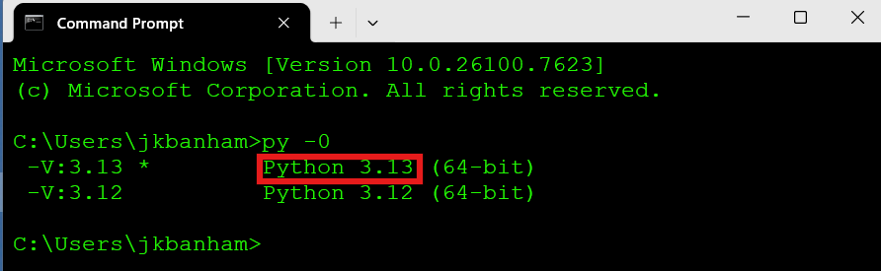
Create A Python Virtual Environment
Check that Python is installed on your workstation:
Open a Windows CLI command window
Type the command py -0 (it’s the number zero) in a command/terminal window
(you should see v3.13.x installed – you may see other versions also)

Slide 20
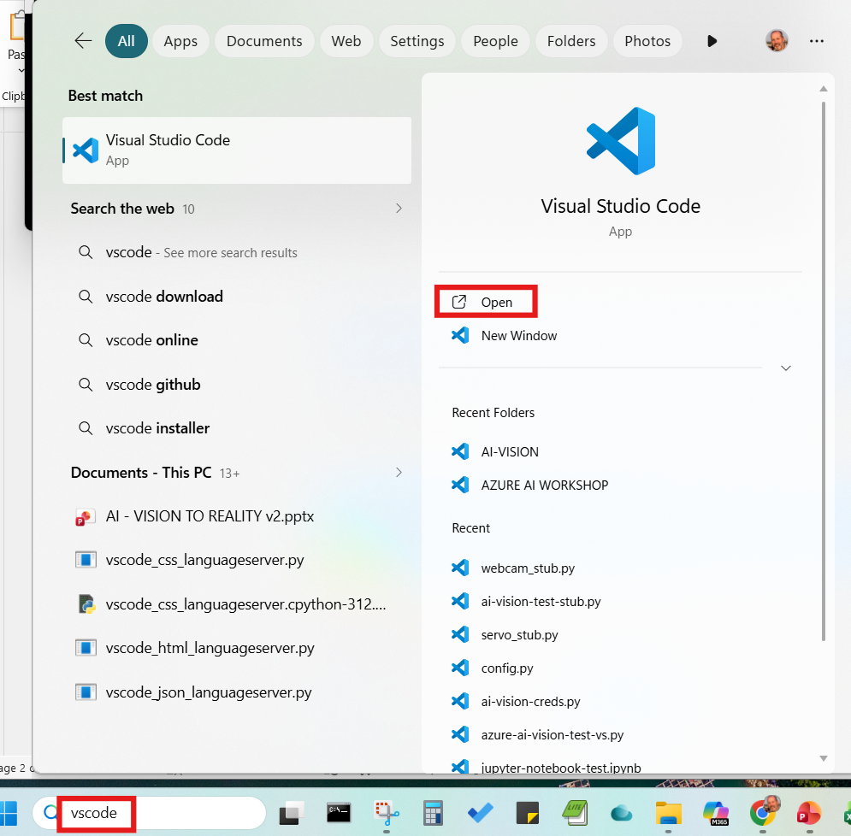
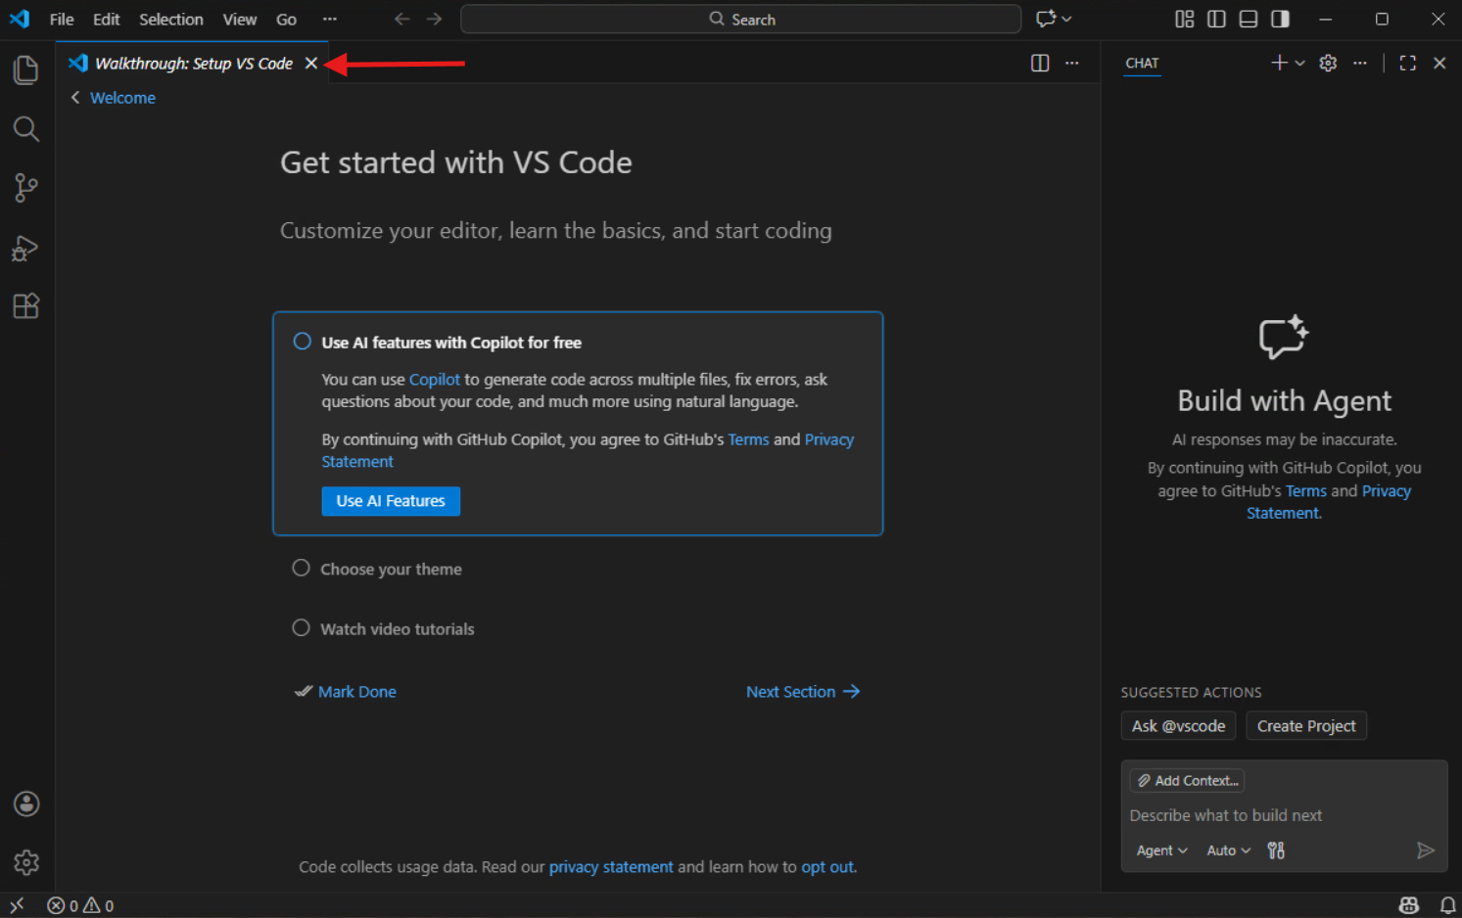
Create Your Python Virtual Environment
2) Launch Microsoft Virtual Studio Code
You can click the ‘X” to close the Walkthrough Setup tab

Slide 21
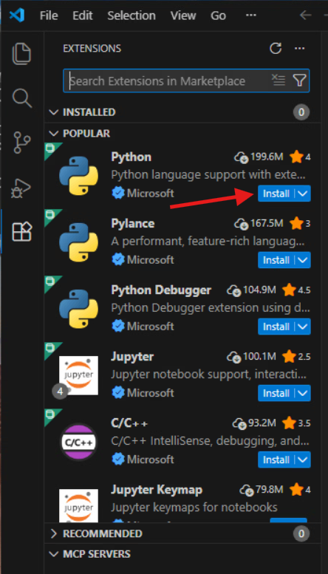
Create A Python Virtual Environment
3) In VSCode, type the CTRL + SHIFT + X keys to bring up the Extensions Window and click the ‘Install’ button for Python. It will take a minute or two to complete the extension installation.

Slide 22
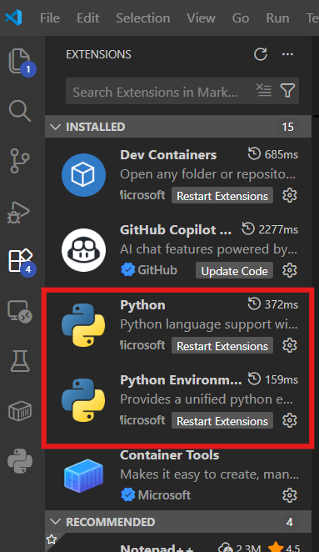
Create A Python Virtual Environment
4) Check that Python is successfully enabled :
You should now see Python in the list under the ‘INSTALLED’ extensions in the left-side panel. (Type CTRL-SHIFT-X again if you need to reopen that panel)

Slide 23
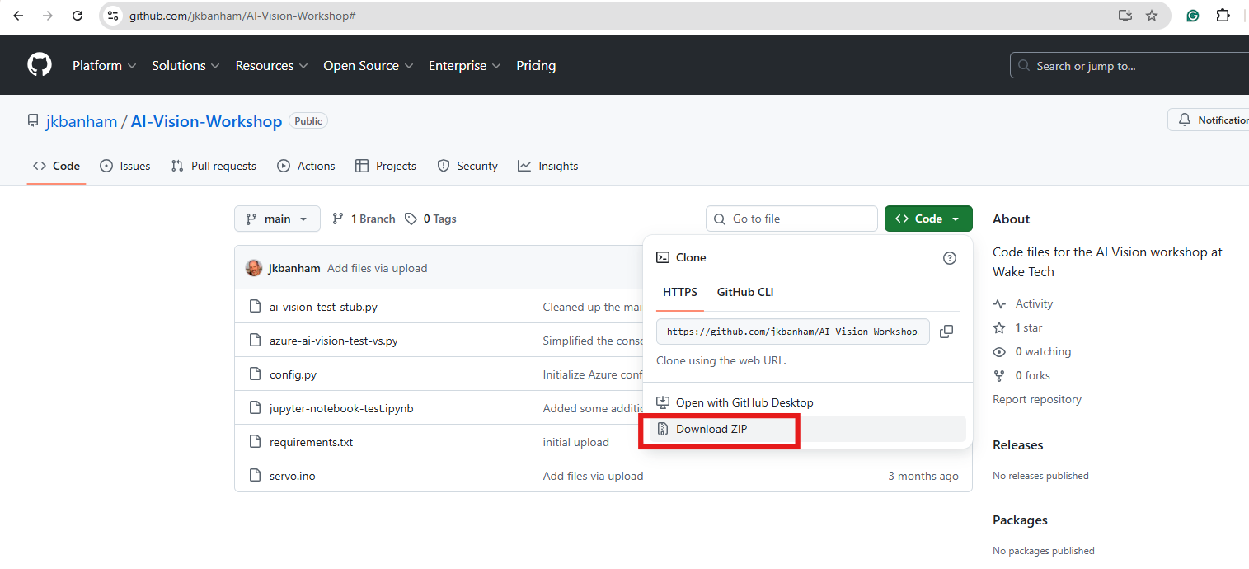
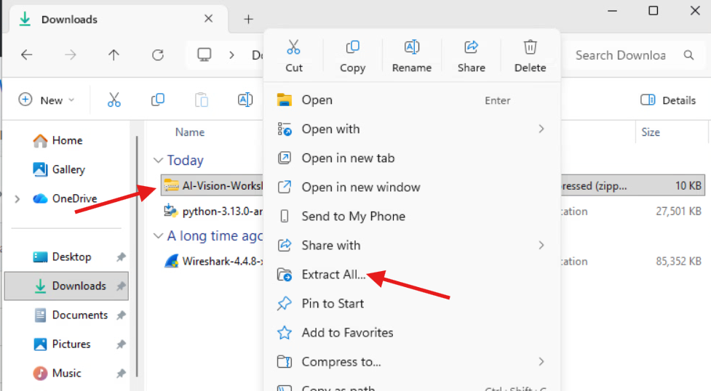
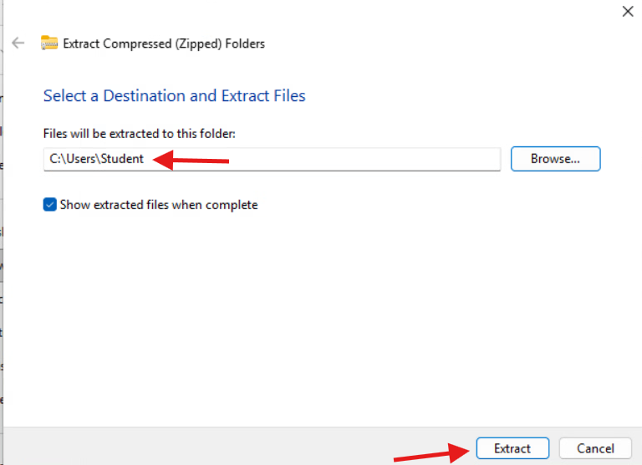
Create A Python Virtual Environment
5) Open a browser and navigate to:
https://github.com/jkbanham/AI-Vision-Workshop
Click the green Code button and select the ‘Download ZIP’ menu choice – the zip file will download into your C:\Users\<your-username>\Downloads folder
Open File Explorer, navigate to your Downloads folder and right-click on the AI-Vision-Workshop-main zip file. Select ‘Extract All’ from the menu
Click the Browse button to select your user folder (C:\Users\<your-username>) as the destination and click the ‘Extract’ button

Slide 24
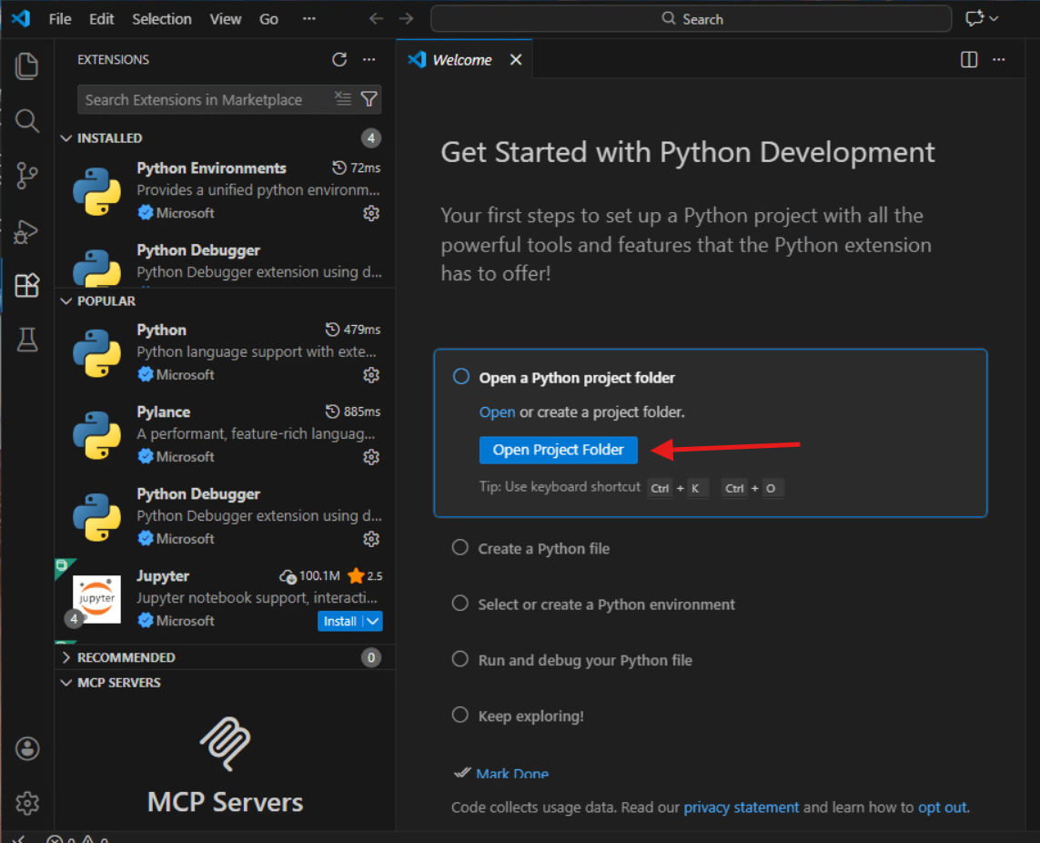
Create A Python Virtual Environment
6) Back in VS Code, click on the ‘Open Project Folder’ button in the Get Started with Python Development window
(Select Help->Welcome if this window isn’t currently showing for you and then click on the ‘Open Folder’ link)

Slide 25
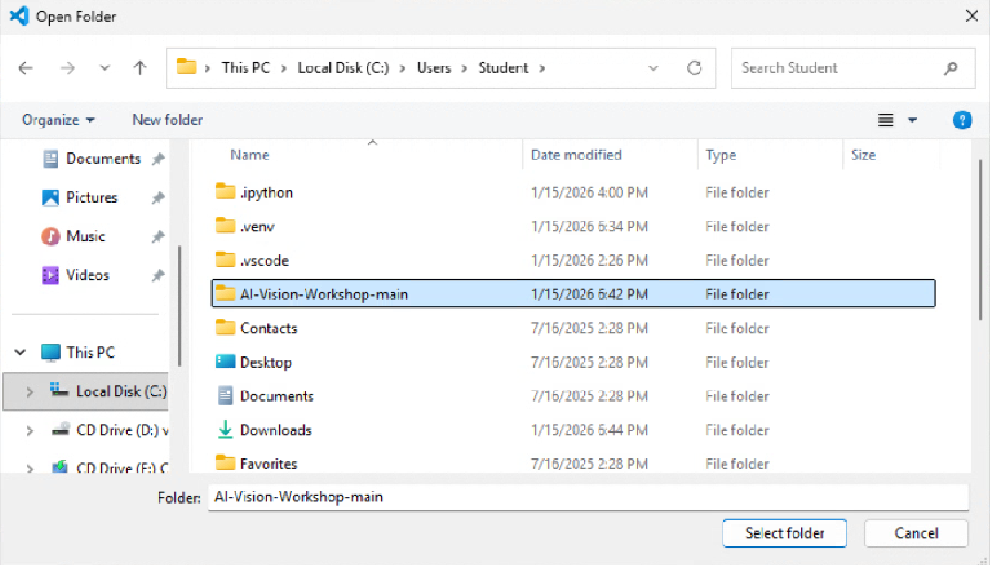
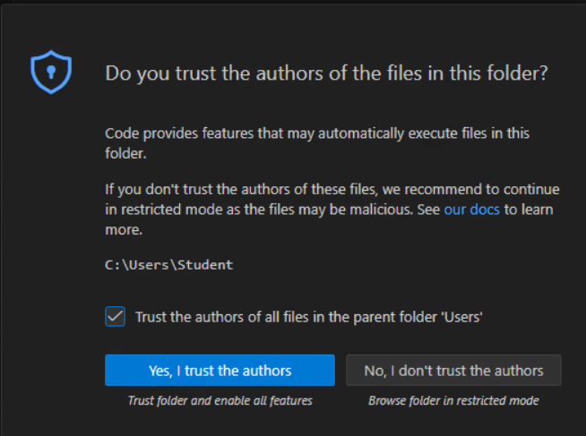
Create A Python Virtual Environment
7) Select the C:\Users\<your-username>\AI-Vision-Workshop-main folder and then click the ‘Trust the authors of all files in the parent folder…’ and click the ‘Yes, I trust the authors’ button

Slide 26
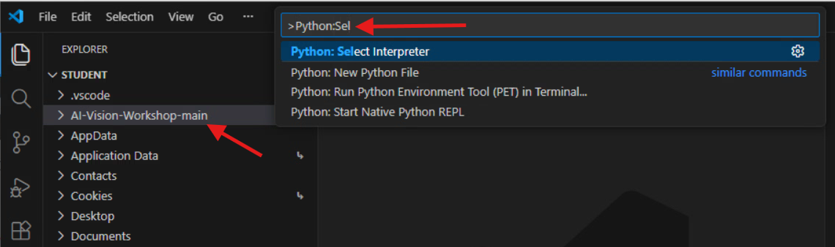
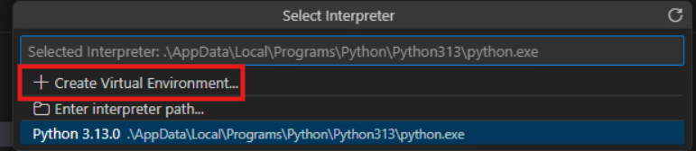
Create A Python Virtual Environment
8) Set the Python Interpreter in VSCode
Back in VSCode, click the ‘AI-Vision-Workshop-main’ folder in the left-side EXPLORER pane.
Type CTRL + SHIFT + P to open the command palette and type Python:Select Interpreter and click it
Click the + Create Virtual Environment option

Slide 27
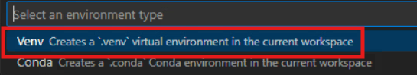
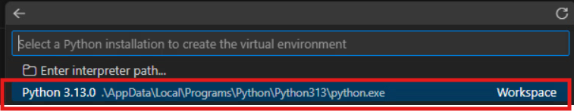
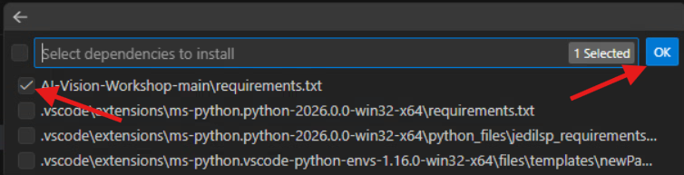
Create Your Python Virtual Environment
Click the ‘Venv Creates a…’ choice
Choose the Python 3.13.x interpreter and click it (your screen might look different – it probably shows version 3.13.5)
Click the check box next to the AI-Vision-Workshop-main\requirements.txt file and then click the OK button
The needed python modules will now be loaded into your environment and you will have a functional virtual python environment created in your project folder – be patient - this can take ~3-4 minutes to complete

Slide 28
CHECKPOINT

Slide 29
Microsoft Azure

Slide 30

What is Microsoft Azure?
Microsoft’s Cloud-based Product & Solutions Suite
Access here: https://portal.azure.com
Some key concepts to understand:
What is a subscription? A billing context
What is a resource group? An organizational context
What is a resource? An implementation of a product or service (ie a virtual machine)
Take a look at all Azure offerings here:
https://azure.microsoft.com/en-us/products

Slide 31
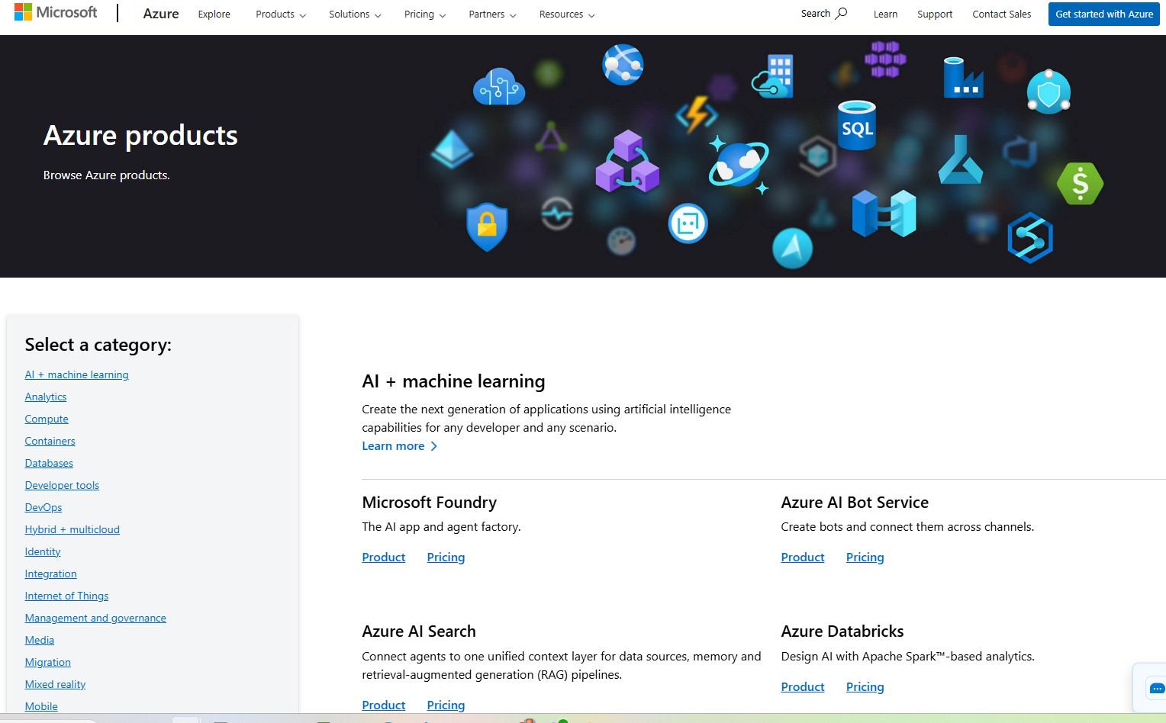
Show all Azure AI products??
https://azure.microsoft.com/en-us/products

Slide 32
What is an API?
Application Programming Interface
If you can’t have a human manually interacting with a system (keyboard, mouse, etc) you can use an API
Enables, machine-to-machine interaction
Security is important / challenging!
We will use API’s so our Python program code can utilize the resources we build in the Microsoft Azure environment

Slide 33


Azure Resources We Will Build Today
Computer Vision – Part of Microsoft’s suite of AI tools and services – it take an image file as input and can analyze it to return many different results such as whether there is text in the image (and what it says), if there are objects in the image (and what they are), if there are people/faces in the image (and specifically where they are in the image), etc.
Storage Blob Container – an internet-accessible (ie public cloud) storage resource where we can easily upload and store image files. Blob storage (Blob storage (Binary Large Object storage) is a highly scalable, cost-effective cloud solution for storing massive amounts of unstructured data, like text, images, videos, audio files, and backups, that doesn't fit traditional database structures.

Slide 34
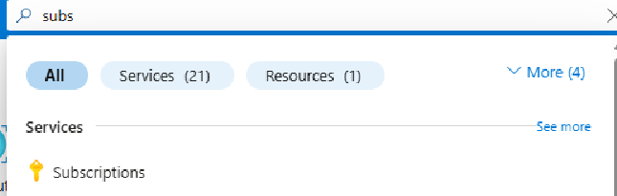
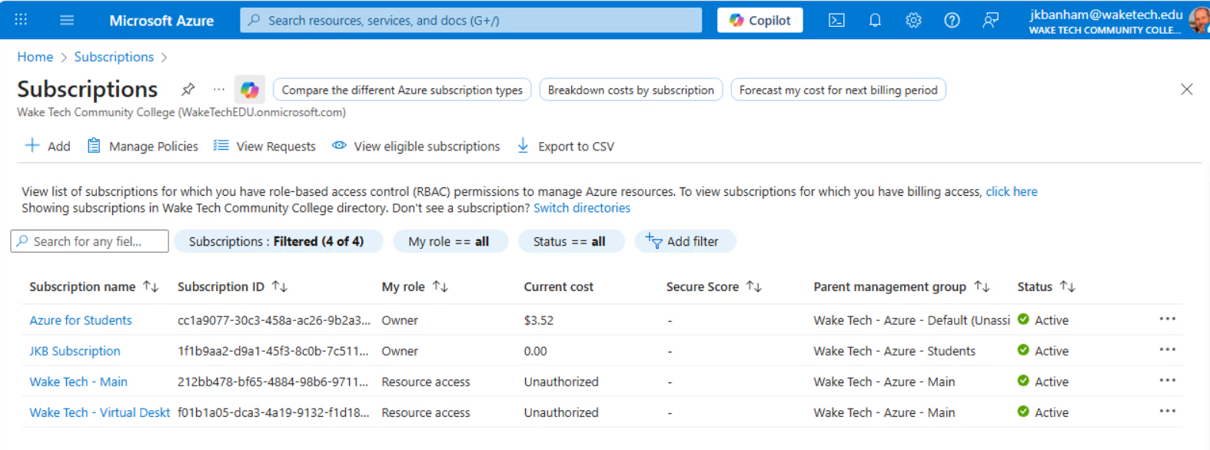
Configure Microsoft Azure Resources
Login to the Microsoft Azure Portal (portal.azure.com) with your Wake Tech key account
Type ‘subsc’ in the search bar at the top of the screen and then click the ‘Subscriptions’ tool
Ensure that you have an active ‘Azure for Students’ subscription in your list

Slide 35
Create an Azure Computer Vision Resource

Slide 36
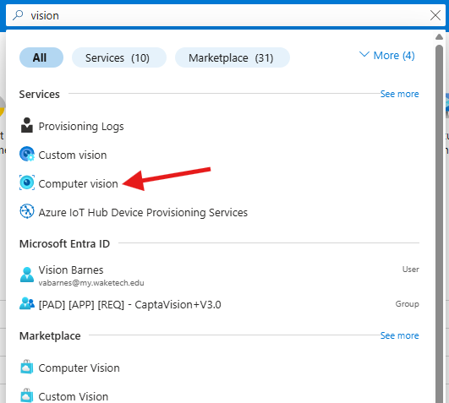
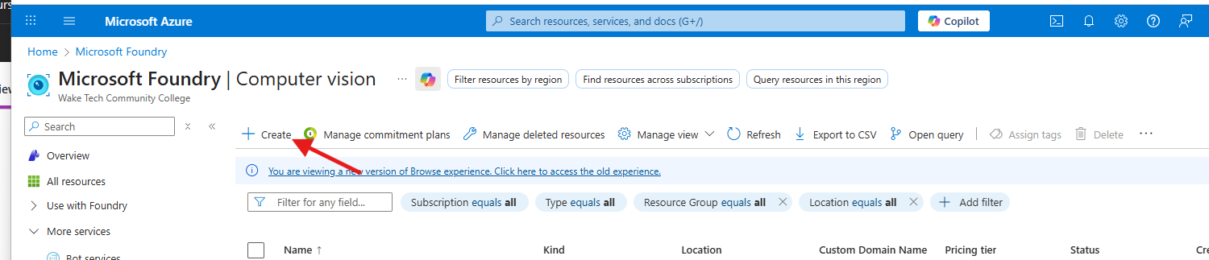
Create an Azure Computer Vision Resource
Log in to your Azure portal account (portal.azure.com)
In the search bar at the top of the screen type ‘vision’
Select the ‘Computer Vision’ resource
The Computer Vision resource page will open. Click the ‘+ Create’ button

Slide 37
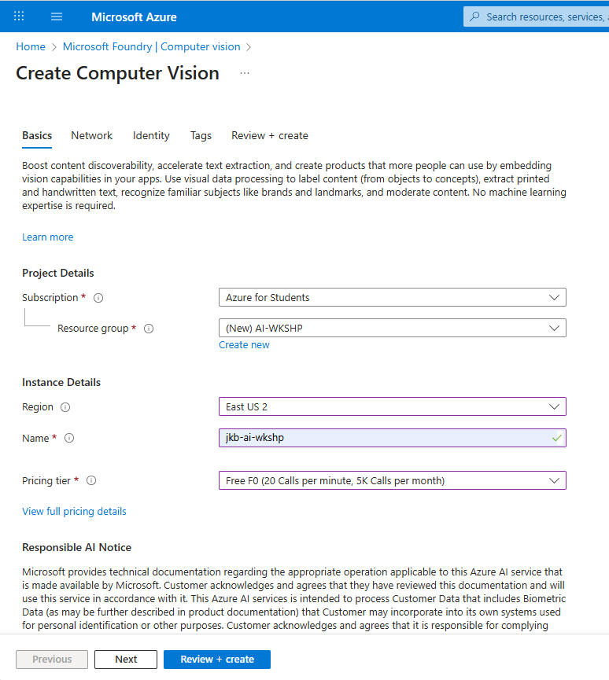
Create an Azure Computer Vision Resource
Complete the config screen as follows:
Subscription: Select your student subscription
Resource group: Click the ‘Create new’ link and create a new Resource group named “AI-WKSHP’
Region: Leave the default choice
Name: Use your initials followed by ‘-ai-wkshp’ For example. I named mine jkb-ai-wkshp
Pricing Tier: Select the Free F0 tier
Scroll down and click the terms acknowledgement box at the bottom and then click the ‘Review + create’ button

Slide 38
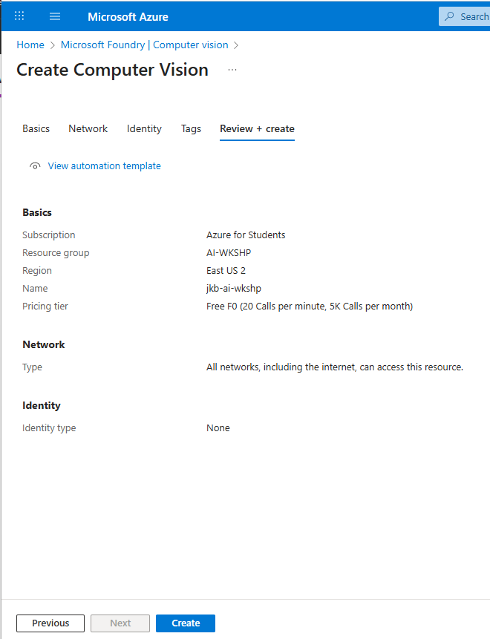
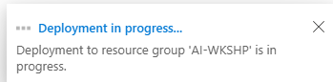
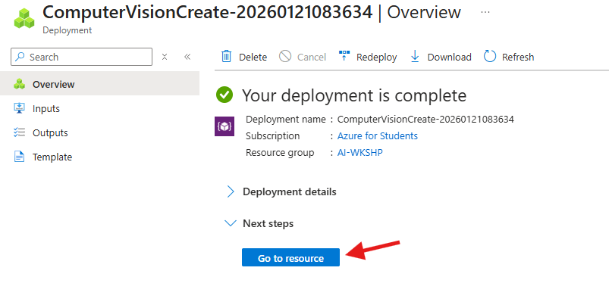
Create an Azure Computer Vision Resource
The config will validate and then you can click the ‘Create’ button.
You will see a ‘Deployment in progress…’ notice for a few moments and then your new resource will be ready.
When the deployment is complete, click on the ‘Go to resource’ button

Slide 39
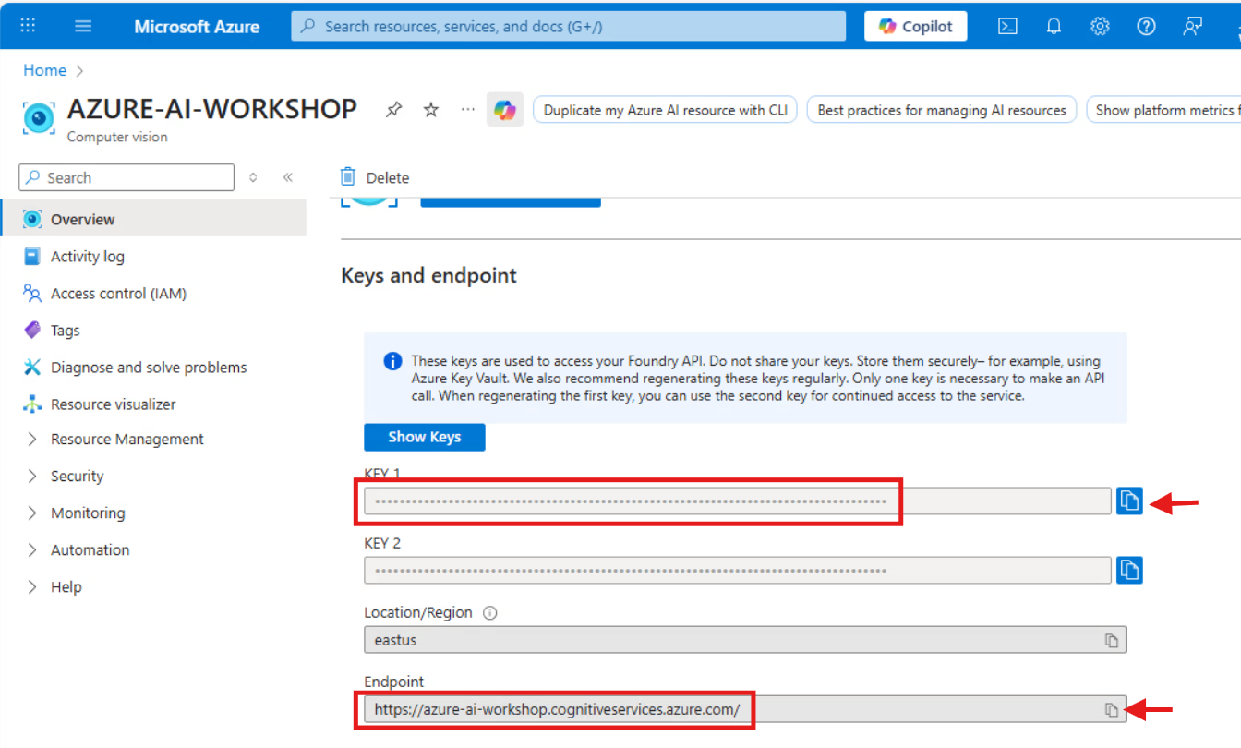
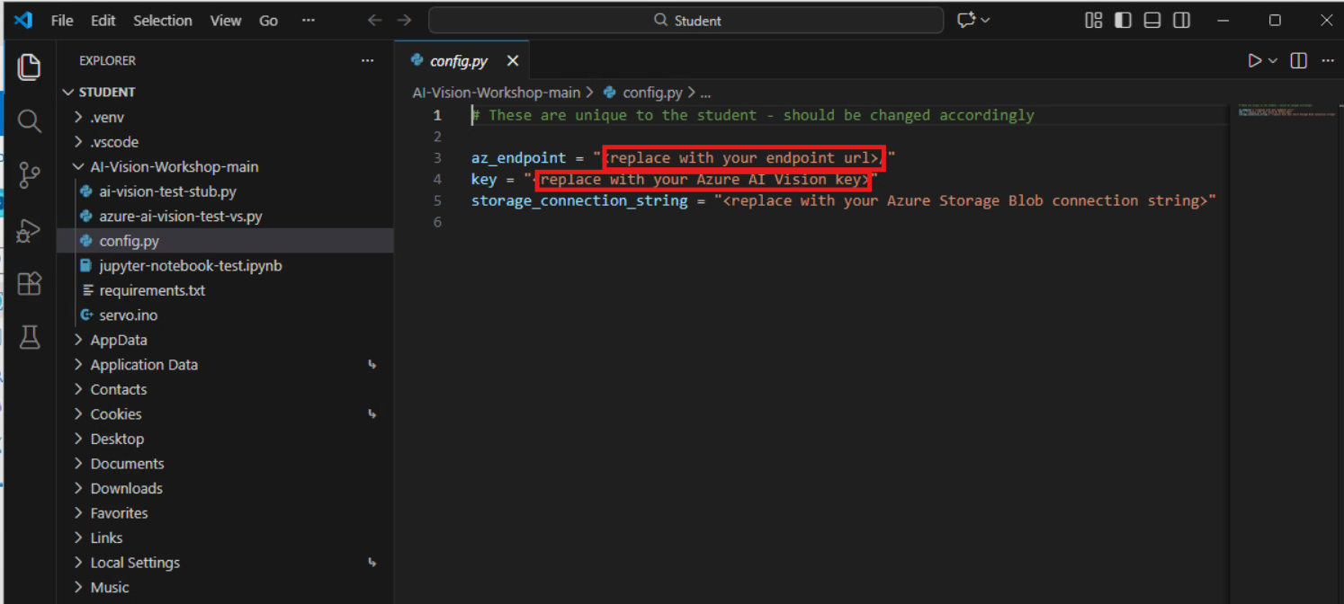
Create an Azure Computer Vision Resource
Click on the new resource name to open its properties
Scroll down and note the values for KEY 1 and Endpoint. We will need to copy these values and paste them into the config.py file (in VSCode)

Slide 40
CHECKPOINT

Slide 41
Create an Azure Storage Account & Storage Blob Container

Slide 42
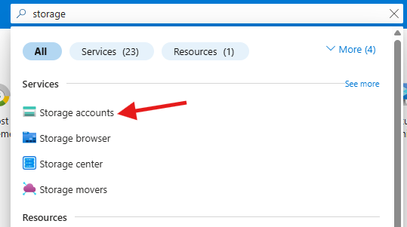
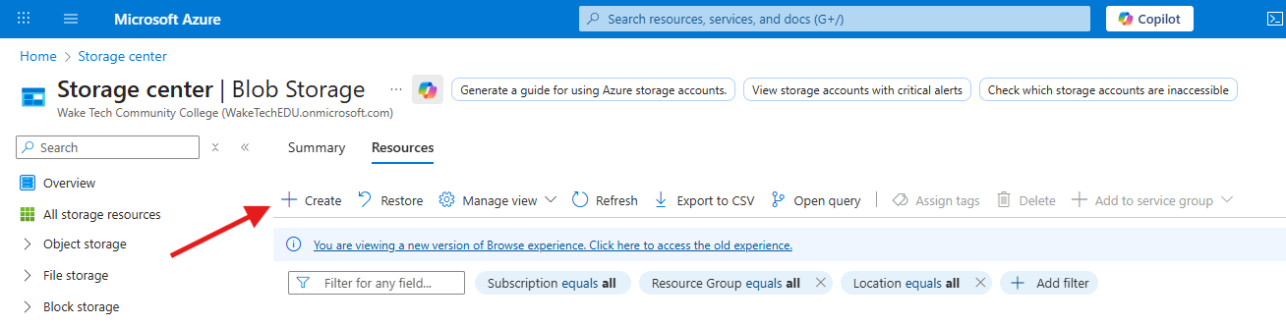
Create an Azure Storage Account
In the Azure portal, type ‘storage’ in the search bar at the top of the screen
Select the ‘Storage accounts’ resource
The Storage center page will open. Click the ‘+ Create’ button

Slide 43
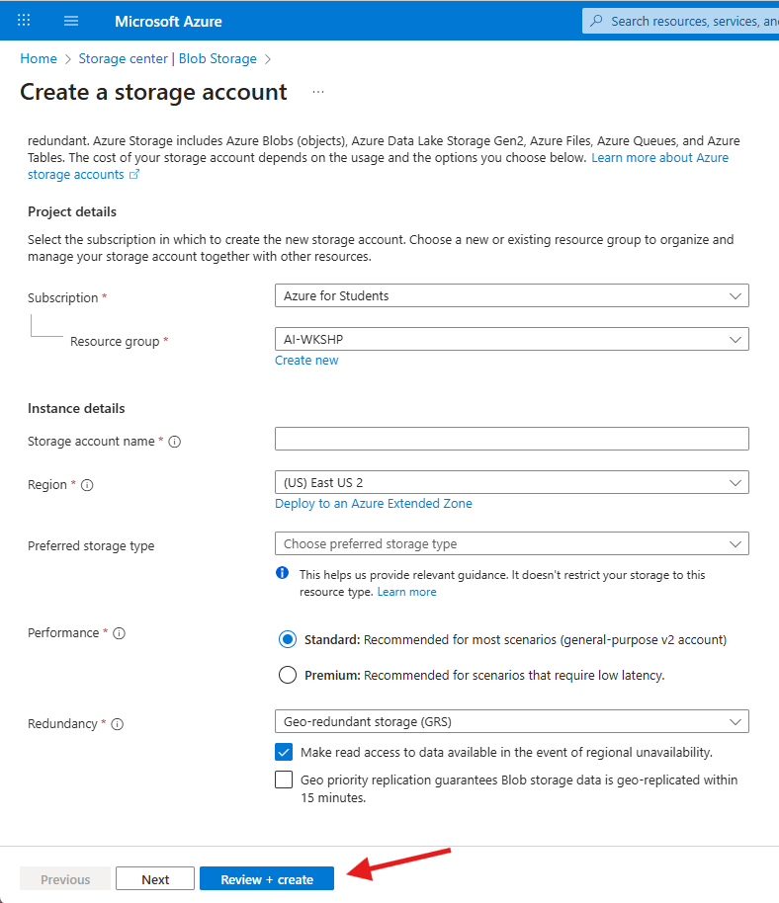
Create an Azure Storage Account
Complete the config screen as follows:
Subscription: Select your student subscription
Resource group: Select the “AI-WKSHP’ resource group that you previously created
Storage account name: Use your initials followed by ‘aiwkshp’ For example. I named mine jkbaiwkshp
Region: Leave the default choice
Preferred storage type: Select ‘Azure Blob Storage or…”
Performance: Leave as Standard
Redundancy: Leave as Geo-redundant
Scroll down and click the ‘Review + create’ button

Slide 44
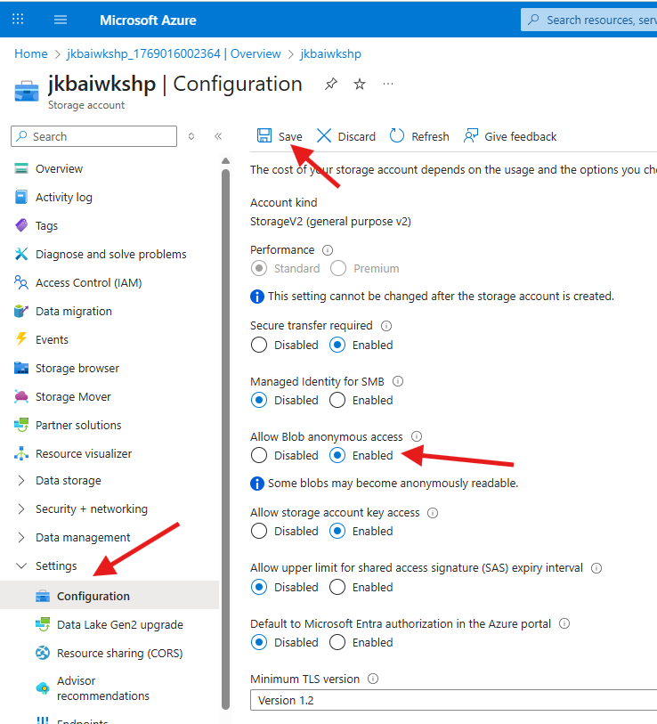
Create an Azure Storage Account
Once the settings validate you can click the ‘Create’ button
You will see a ‘Deployment in progress…’ notice for a few moments and then your new resource will be ready.
When the deployment is complete, click on the ‘Go to resource’ button
In the left-hand pane, expand the ‘Settings’ menu and select ‘Configuration’
Change the ‘Allow Blob anonymous access’ setting to ‘Enabled’ and then click the ‘Save’ button at the top of the screen

Slide 45
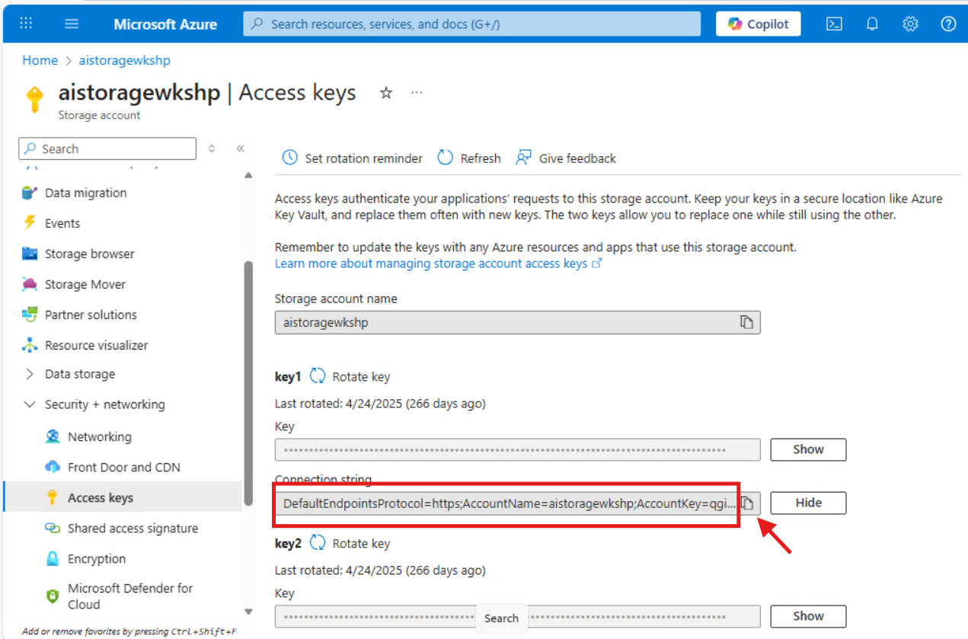
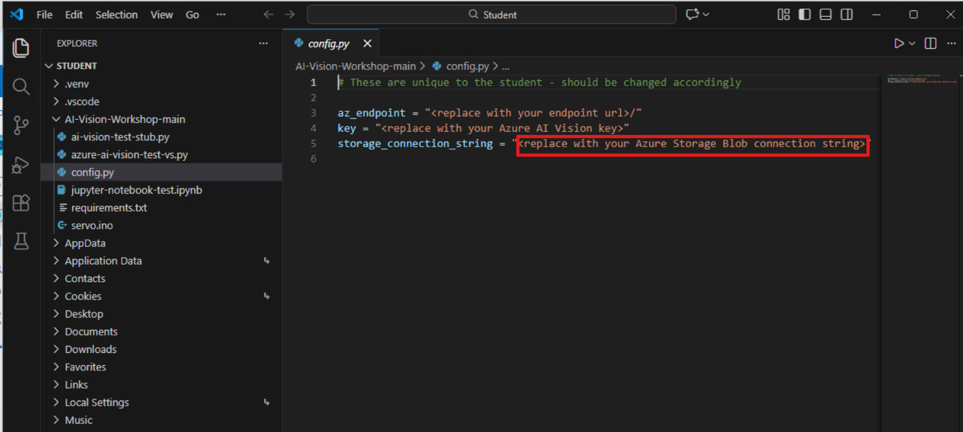
Create an Azure Storage Account
In the left-hand pane, expand the ‘Security + networking’ menu and select ‘Access keys’
Scroll down and note the value of the Connection string. We will need to copy this value into the config.py file (in VSCode)

Slide 46
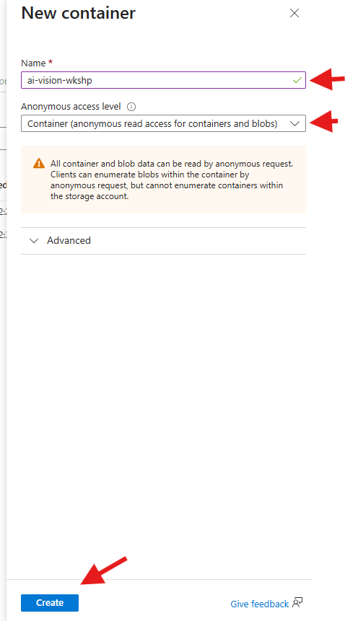
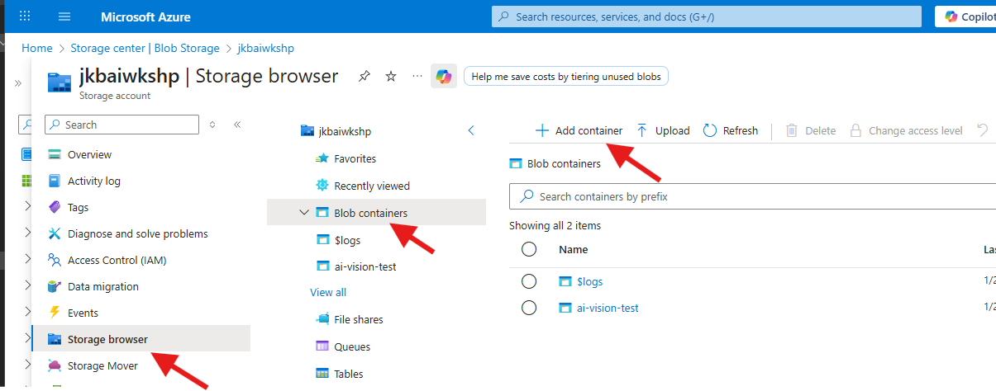
Create an Azure Storage Blob Container Resource
In the left-hand pane, click the ‘Storage browser’ then click ‘Blob containers’ and then click ‘+ Add container’
In the ‘New container’ panel, name the container ai-vision-wkshp and set the Anonymous access level to ‘Container (anonymous read access…’ Then click Create at the bottom of the pane

Slide 47
CHECKPOINT

Slide 48

LUNCH BREAK
Presidio Info Goes Here

Slide 49
Jupyter Notebook

Slide 50
What is Jupyter Notebook?
How & Why to Use
Info about what VSCode will do the first time you run a cell (details on next few slides)
Step thru all of the code except for the last Arduino block (ie test webcam, etc)
Caption issue on free tier

Slide 51
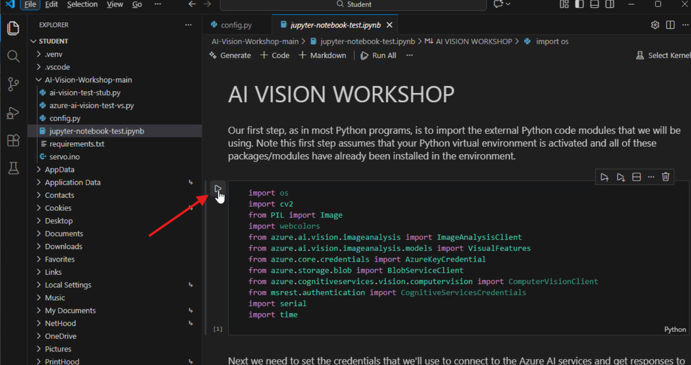
Jupyter Notebook Stuff

Slide 52
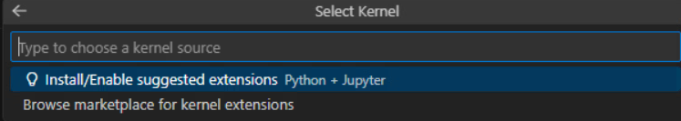
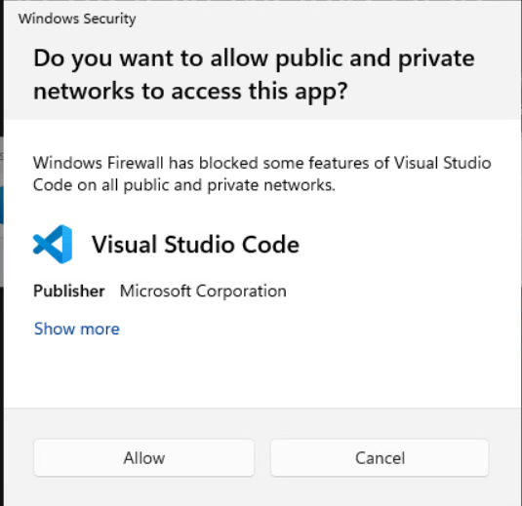
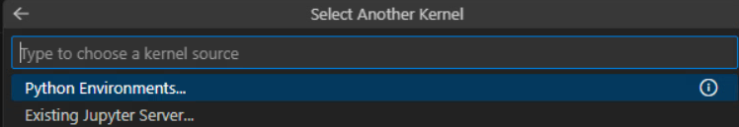
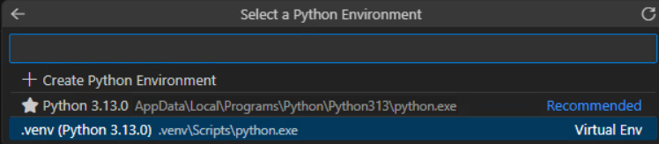
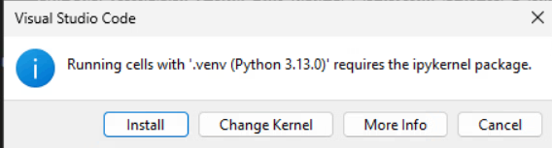
Jupyter Notebook Stuff
Nonotete –click Cancel on fwall prompt

Slide 53
CHECKPOINT

Slide 54
Arduino

Slide 55
Couple of slides here about the Arduino
What is Arduino
How to set it up /connect it
Wire it into the servo motor
Put the popsicle stick on the motor, etc
Add slide abouty checking the com port

Slide 56
CHECKPOINT

Slide 57
Putting It All Together

Slide 58
OBJECT 1
OBJECT 2

Slide 59
AI Model Training

Slide 60
Futures Stuff
https://github.com/ngxson/smolvlm-realtime-webcam
SmolVLM real-time camera demo: https://www.reddit.com/r/LocalLLaMA/comments/1klx9q2/realtime_webcam_demo_with_smolvlm_using_llamacpp/

Slide 61
Wrap Up / What’s Next?
Things to do next
Useful Links for more learning
KEEP LEARNING
COLLABORATE
STAY IN TOUCH!

Slide 62
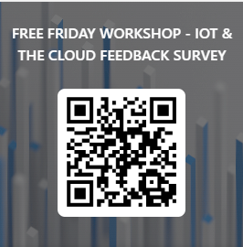
Please take a moment to complete this short feedback form – it will help us to improve the workshop for future students!
Update url for feedback form

Slide 63

Thank you

Slide 64

Info about innovation project funding acknowledgement
This material is the property of Wake Tech Community College and should not be reproduced or shared without prior written permission.
Please contact Jeff Banham (jkbanham@waketech.edu) for more info.

